Slide 1
Assignment No. 11
Title: Strategy Design Pattern
Aim: Implement and apply Strategy Design pattern for simple Shopping Cart where three payment strategies are used such as Credit Card, PayPal, BitCoin. Create the interface for strategy pattern and give concrete implementation for payment.
Objectives: To learn the concept of strategy design pattern
Theory:
Strategy design pattern
Design pattern representation
Intent of Design pattern
Solution of given context with diagram

Slide 2
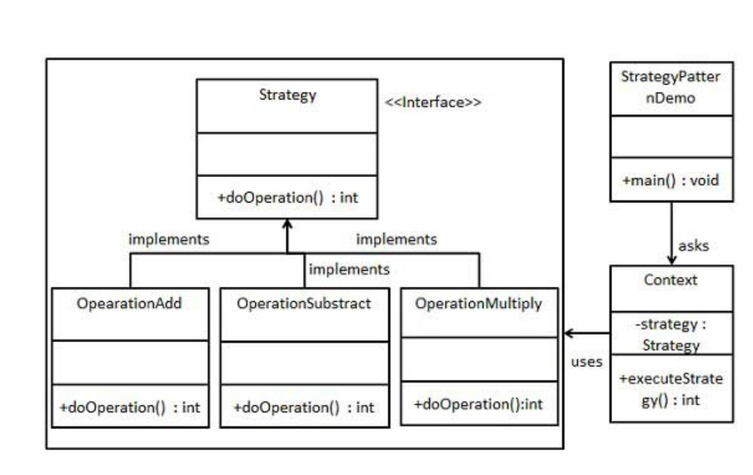
Assignment No. 11
In Strategy pattern, a class behavior or its algorithm can be changed at run time. This type of design pattern comes under behavior pattern. In Strategy pattern, we create objects which represent various strategies and a context object whose behavior varies as per its strategy object.
The strategy object changes the executing algorithm of the context object.
We are going to create a Strategy interface defining an action and concrete strategy classes implementing the Strategy interface. Context is a class which uses a Strategy.
StrategyPatternDemo, our demo class, will use Context and strategy objects to demonstrate

Slide 3
Sample -Assignment No. 11
Step 1
Create an interface.
Strategy.java
public interface Strategy
{ public int doOperation(int num1, int num2);
}
Step 2
Create concrete classes implementing the same interface.
OperationAdd.java
public class OperationAdd implements Strategy{
@Override
public int doOperation(int num1, int num2)
{
return num1 + num2;
}
}
OperationSubstract.java
public class OperationSubstract implements Strategy
{ @Override
public int doOperation(int num1, int num2)
{
return num1 - num2;
}
}
OperationMultiply.java
public class OperationMultiply implements Strategy
{ @Override
public int doOperation(int num1, int num2)
{ return num1 * num2;
}
}

Slide 4
Sample -Assignment No. 11
Step 3
Create Context Class.
Context.java
public class Context
{
private Strategy strategy;
public Context(Strategy strategy){
this.strategy = strategy;
}
public int executeStrategy(int num1, int num2){ return strategy.doOperation(num1, num2);
}
}
Step 4
Use the Context to see change in behaviour when it changes its Strategy.
StrategyPatternDemo.java
public class StrategyPatternDemo {
public static void main(String[] args) {
Context context = new Context(new OperationAdd());
System.out.println("10 + 5 = " + context.executeStrategy(10, 5));
context = new Context(new OperationSubstract());
System.out.println("10 - 5 = " + context.executeStrategy(10, 5));
context = new Context(new OperationMultiply());
System.out.println("10 * 5 = " + context.executeStrategy(10, 5));
}
}
Output:
10 + 5 = 15
10 - 5 = 5
10 * 5 = 50

Slide 5
Assignment No. 11
Test case or Validation:
Identify an algorithm (i.e. a behavior)
Specify the signature for that algorithm in an interface.
Bury the alternative implementation details in derived classes.
Text Book referred for assignment 11
Erich Gamma, Richard Helm ,Ralph Johnson, John Vlissides, “Design Patterns ,Elements of Reusable Object- Oriented Software” ISBN-13: 978-0201633610
Rohit Joshi, “Java Design patterns, Reusable solutions to common problems” Java Code Geeks

Slide 6
Assignment No. 11
Frequently Asked Question:
Give intents of Strategy Design pattern
How problems can be designed and solved using design pattern
Represent Solution of real world problem using Strategy design pattern
Give Real-World Analogy of strategy design pattern .
Design application by applying the Strategy design pattern .
Represent and implement Strategy design pattern to perform mathematical operations such as add,sub,mul,div
Represent and implement Strategy design pattern for sorting operation such as Quick sort ,Merge sort etc
Represent and implement Strategy design pattern for searching techniques such as Sequential Search, Binary Search etc.
Mapping of Course Outcomes for Assignment 11: CO6
CO6: Apply appropriate design patterns to provide object-oriented solutions

Slide 7
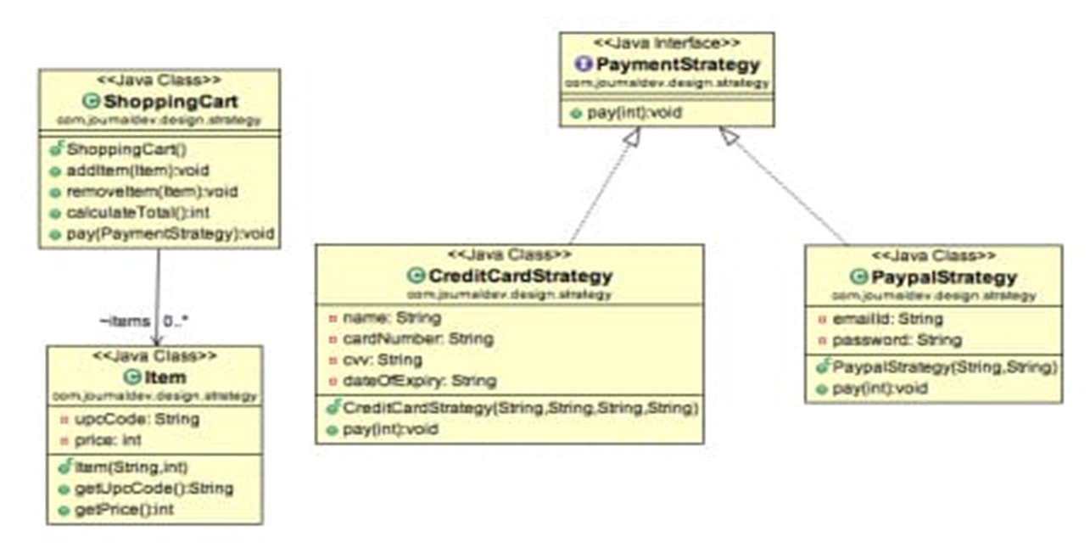

Slide 8
Assignment No. 11
CreditCardStrategy .java
package strategyclass;
public class CreditCardStrategy implements PaymentStrategy {
private String name;
private String cardNumber;
private String cvv;
private String dateOfExpiry;
public CreditCardStrategy(String nm, String ccNum, String cvv, String expiryDate){
this.name=nm;
this.cardNumber=ccNum;
this.cvv=cvv;
this.dateOfExpiry=expiryDate;
}
@Override
public void pay(int amount) {
System.out.println(amount +" paid with credit/debit card");
}
}
Item.java
package strategyclass;
public class Item {
private String upcCode;
private int price;
public Item(String upc, int cost){
this.upcCode=upc;
this.price=cost;
}
public String getUpcCode() {
return upcCode;
}
public int getPrice() {
return price;
}
}

Slide 9
Assignment No. 11
package strategyclass;
public interface PaymentStrategy {
public void pay(int amount);
}
package strategyclass;
import java.text.DecimalFormat;
import java.util.ArrayList;
import java.util.List;
public class ShoppingCart {
//List of items
List<Item> items;
public ShoppingCart(){
this.items=new ArrayList<Item>();
}
public void addItem(Item item){
this.items.add(item);
}
public void removeItem(Item item){
this.items.remove(item);
}
public int calculateTotal(){
int sum = 0;
for(Item item : items){
sum += item.getPrice();
}
return sum;
}
public void pay(PaymentStrategy paymentMethod){
int amount = calculateTotal();
paymentMethod.pay(amount);
}
}
package strategyclass;
public class PaypalStrategy implements PaymentStrategy {
private String emailId;
private String password;
public PaypalStrategy(String email, String pwd){
this.emailId=email;
this.password=pwd;
}
@Override
public void pay(int amount) {
System.out.println(amount + " paid using Paypal.");
}
}

Slide 10
Assignment No. 11
package strategyclass;
public class ShoppingCartTest {
public static void main(String[] args) {
ShoppingCart cart = new ShoppingCart();
Item item1 = new Item("1234",60);
Item item2 = new Item("5678",40);
cart.addItem(item1);
cart.addItem(item2);
//pay by paypal
cart.pay(new PaypalStrategy("myemail@example.com", "pwd"));
//pay by credit card
cart.pay(new CreditCardStrategy("Aparna Bindage", "1234567890123456", "786", "12/15"));
}
}
Strategy Pattern –
100 paid using Paypal.
100 paid with credit/debit card
BUILD SUCCESSFUL (total time: 1 second)

Slide 11
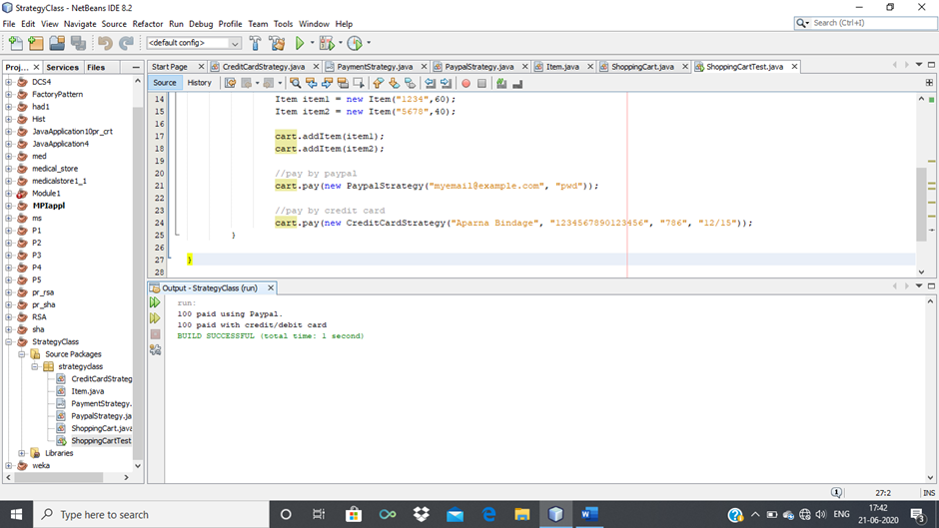

Slide 12
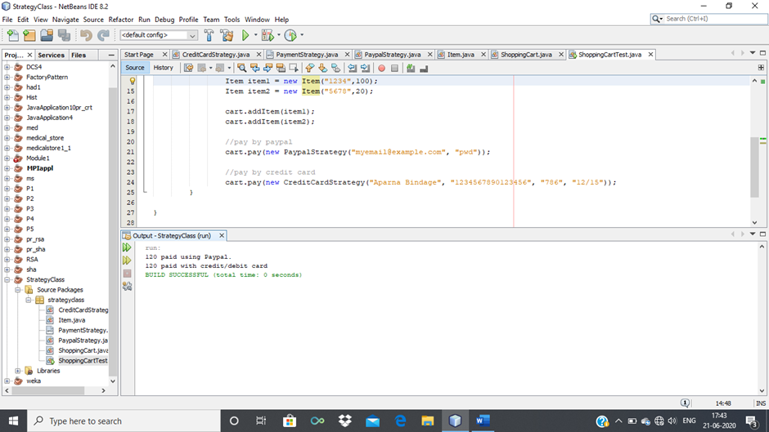
120 paid using Paypal.
120 paid with credit/debit card
BUILD SUCCESSFUL (total time: 0 seconds)

